Slide 1
Service Robot
Product Specification

Slide 2


Content
APP Icon
Loading page
Service Robot Main Page
Sub-Process Visit
Sub-Process Deliver
Sub-Process Interview
Sub-Process Onboard
Admin Website
System Requirements

Slide 3
APP Icon
Pactera Service

Slide 4
Loading
Pactera Edge Service System

Slide 5





Pactera Edge Service Robot
Visit
Deliver
Interview
Onboard

Slide 6

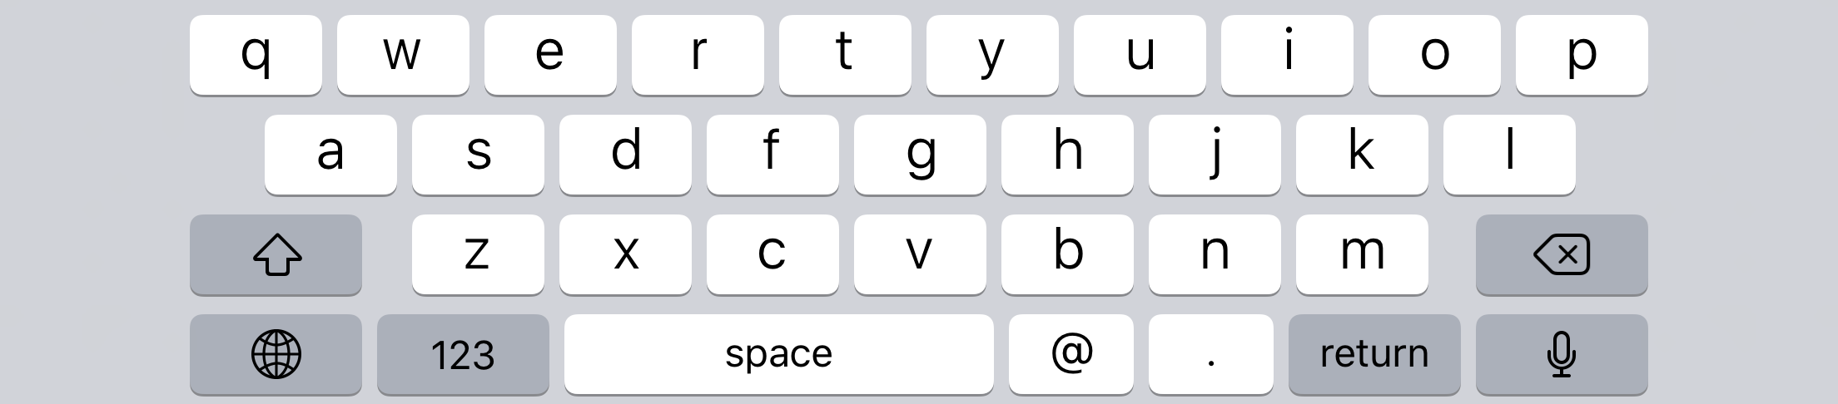
Visit – Check In
Could you please help to check in at first if you want to visit our employee?
Input your name
Input your phone number
Input your visit reason
Submit

Slide 7

Visit – Visit our employee
Choose Department then input our employee name, or input employee name directly.
Choose Department
Input our employee name
Search

Slide 8

Visit – Contact
SMS or Call our employee
Name: Mike
Gender: Male
+1 9120 7884
Call
SMS

Slide 9
Deliver – Contact
Call our Delivery Contact Point
Name: Nancy
Gender: Female
+1 9120 7888
Call

Slide 10
Interview – Check In
Could you please help to check in at first?
Input your name
Input your phone number
Submit

Slide 11
Interview – Interview Process
Pending for Customer provide the details process

Slide 12
Onboard – Onboard Process
Pending for Customer provide the details process

Slide 13
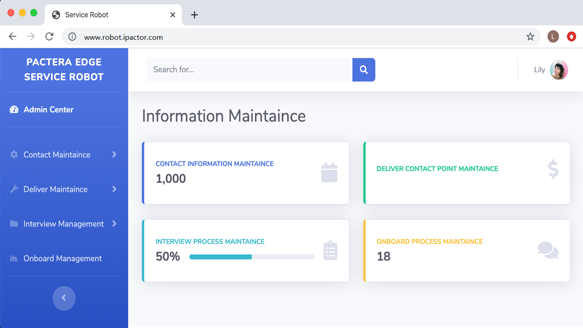
Admin Website

Slide 14
System Requirements
Android APP:
Web Admin Page:
API:
Database:
Horizontal and vertical screen adaptation
Galaxy Tab S5e 4G 10.5 inch 2560 x 1600
https://www.samsung.com/cn/tablets/galaxy-tab-s5e-4g/SM-T725CZDLCHC/
Bootstrap
https://startbootstrap.com/themes/sb-admin-2/
Asp.net, C#
Android APP call backend API services;
Prefer MySQL;

Slide 15
Q & A

Slide 16
THANK YOU

